Slide 1




HYPER PERSONALIZATION
AND
RECOMMENDATION

Slide 2




Team Perzonix
Bhagabat ​
Rashmi​
Subas​
Naresh​
Arun ​​

Slide 3






AGENDA ​
Problem Statement​
Goal​
Technology Stack ​
Technical Overview ​
Advantages
Challenges
Test Results
Future Scope

Slide 4
Problem Statement
Modern customers seek highly personalized experiences tailored to their unique preferences. This challenge involves developing a Generative AI-powered solution that enhances hyper-personalization by analyzing customer profiles, social media activity, purchase history, sentiment data, and demographic details.
The objective is to design a system that generates customized recommendations for products, services, or content while also providing actionable insights to help businesses optimize customer engagement.

Slide 5

Goal
The goal is to build a Generative AI-powered solution that delivers highly personalized recommendations, helping businesses enhance customer satisfaction, boost retention, and drive revenue growth. Additionally, the solution aims to provide actionable insights that enable businesses to refine their marketing strategies and improve overall customer engagement.

Slide 6

Technology Stack
Language :
Python
ML Models & Libraries :
Transformers
Touch
Langchain
ChromaDB
Hugging Face
Pandas
Faker
Streamlit

Slide 7

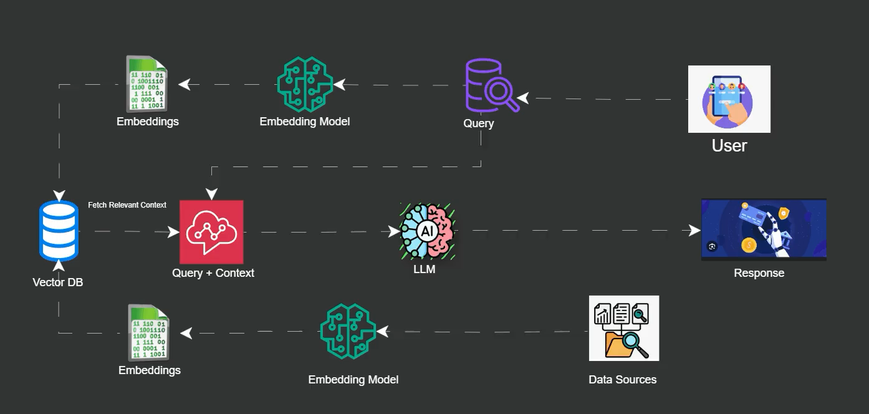

Technical Overview

Slide 8
Advantages
Enhanced Customer Experience: Tailored recommendations create more relevant and meaningful interactions, increasing customer satisfaction.
Improved Customer Retention: Personalized experiences foster stronger customer loyalty, reducing churn rates.
Data-Driven Insights: The system provides valuable insights into customer behaviour, helping businesses make informed decisions.
Increased Revenue: Personalized offers and recommendations can lead to higher conversion rates and larger average order values.
Efficient Marketing Strategies: Actionable insights allow businesses to optimize their marketing campaigns, making them more effective and targeted.

Slide 9
Challanges
Large-Scale Data Processing → Efficient storage and retrieval of vast customer datasets.
AI Model Optimization → HuggingFaceH4/zephyr-7b-beta required GPU acceleration and tuning for real-time performance.
Vector Database Performance → Optimizing ChromaDB for fast and scalable embeddings retrieval.
Complex Sentiment Analysis → Extracting insights from unstructured, slang-heavy social media data.
Privacy & Compliance → Balancing personalization while ensuring financial data privacy (e.g., GDPR).
UI & Performance → Keeping the Streamlit app responsive with real-time recommendations.

Slide 10
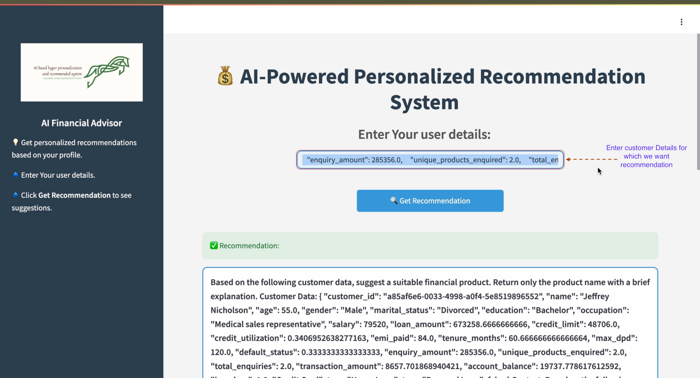
Test Results

Slide 11
Future Scope
Real-Time Banking API Integration → Fetch live transaction & credit data for dynamic recommendations.
Enhanced AI Models → Fine-tune LLMs with reinforcement learning for better financial insights.
Improved Sentiment Analysis → Use multimodal AI (text + voice + images) for deeper sentiment understanding.
Scalable Cloud Deployment → Deploy as a microservice for enterprise-grade performance.
Advanced Personalization → AI-driven financial goal tracking & predictive spending analysis.
Regulatory Compliance → Implement explainable AI (XAI) for compliance with financial laws.

Slide 12
THANK YOU!

